Slide 1
Getting started in Codespace
A guide for students

Slide 2
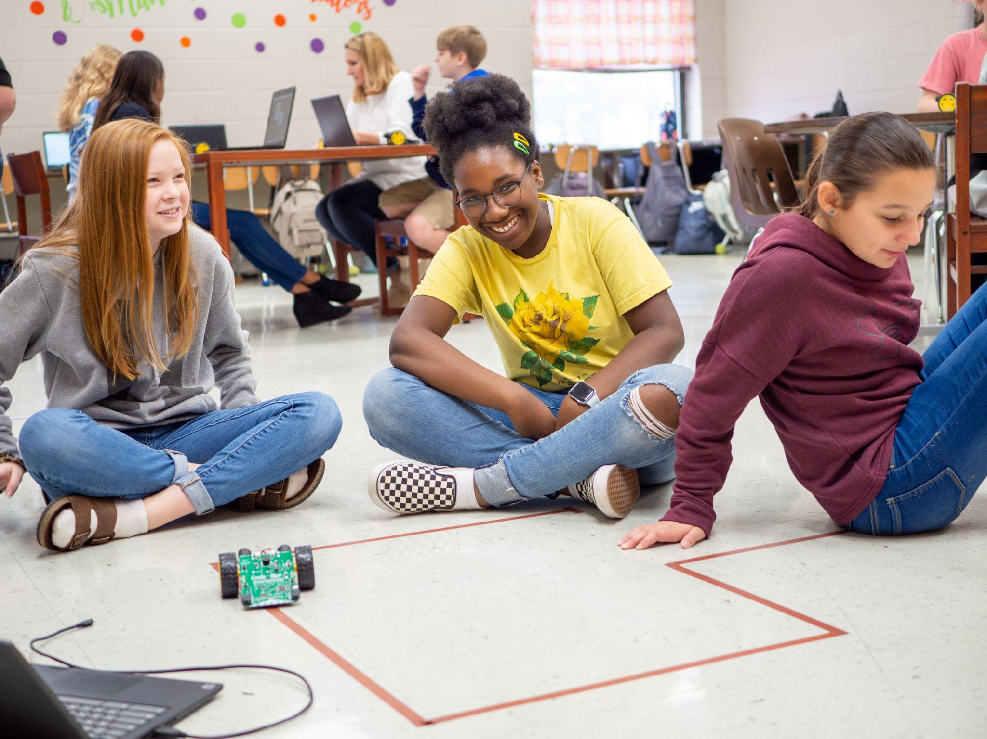
Python with Robotics using the CodeBot
You are about to start an exciting
adventure into programming with
Python!
You need to type your programs, or
code, somewhere. Instead of using
a Google Doc or Microsoft Word, you are going to use a special text editor called CodeSpace.

Slide 3
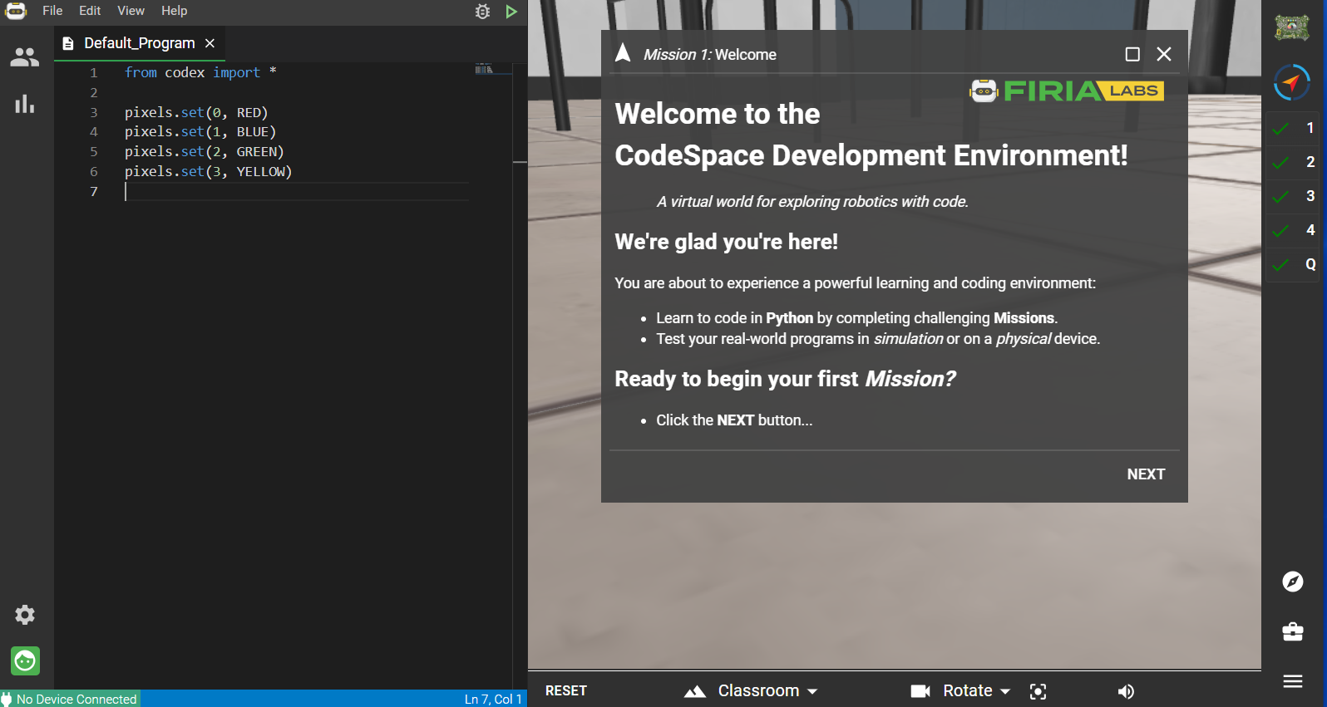
Python with Robotics using the CodeBot
To use CodeSpace, you will create a free account and use a code from your teacher to join your class.
Don’t worry -- this is easy! All you need is an email.

Slide 4

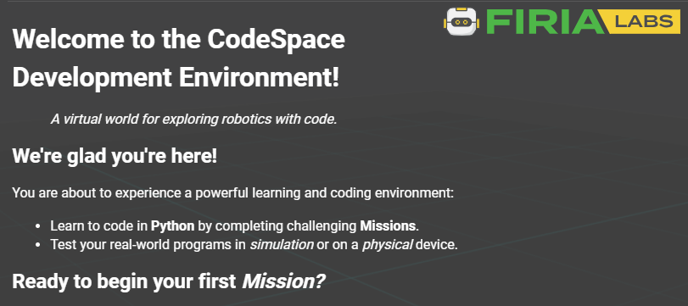
Open CodeSpace:
Open the Chrome browser
Use the link below, or type the URL directly into the browser: https://make.firialabs.com/

Slide 5
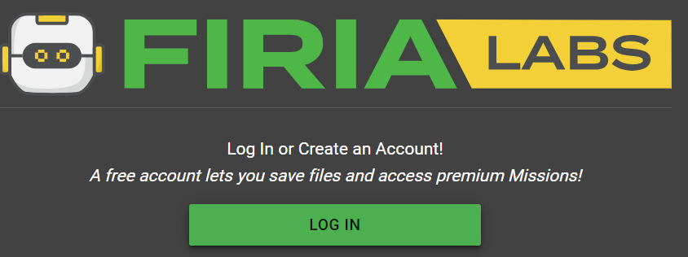
Click “Log in”

Slide 6
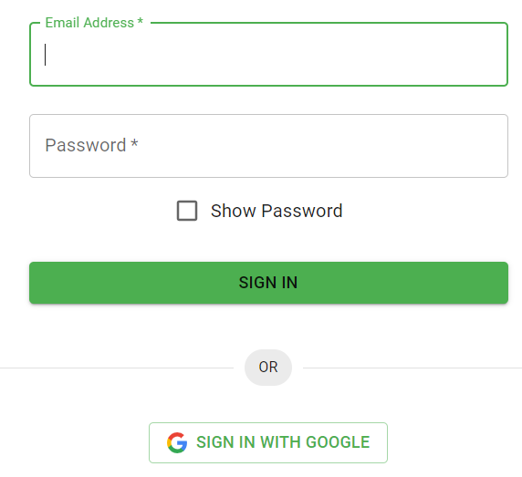
Sign in:
You can:
Create an account using your email address
–or–
Sign in with Google and select your gmail

Slide 7

CodeSpace
After you log in, examine the CodeSpace environment.
On the bottom left of the editor window are two icons
  Setting preferences
  Log in / log out

Slide 8

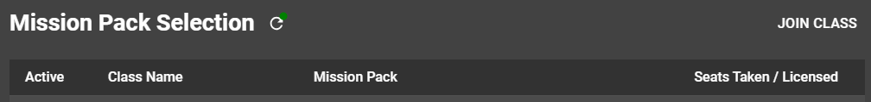
Join your class
On the top left of the editor window is the class icon
Click on the icon
Then click “JOIN CLASS”

Slide 9
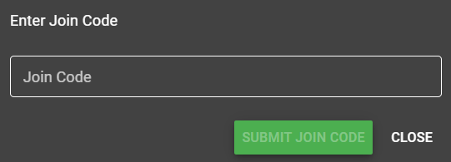
Join your class
Enter the code from your teacher
Then click “SUBMIT JOIN CODE”

Slide 10

All set!
Your class is now activated.
You should see these icons in the upper right hand corner of the window:

Slide 11
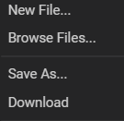
Things to remember
Your program files are saved automatically, all the time, in the cloud.
Start a new program with
“New File”.
You can open earlier programs by going to “Browse Files…”

Slide 12
Things to remember
If you want to make changes to a program, but keep the original code, “Save As…” with a new name.
You can download a text file of your code with “Download”.

Slide 13
You are ready to begin!
Go to Mission 1 and get started!

